Slide 1
Convolutional Neural Networks

Slide 2

Some Facts...
Inspired by Hubel and Wiesel’s experiments in vision
Base on Neocognitron - 1980’s
Invented by Yann LeCun
AlexNet’s win in the 2012 ImageNet competition was a CNN architecture
Currently the de facto image search algorithm
Can be used in time series tasks, audio tasks like speech to text, language processing and others
Yann Lecun, co-winner of the ACM Turing Award
Notes:
Hubel was instrumental in the mapping of the brain and the discovery of platicity

Slide 3
The Importance of Vision
60% of the Brain
Images sizes in computers and processing time
A brain runs on 40 Watts - not much more than a lightbulb

Slide 4
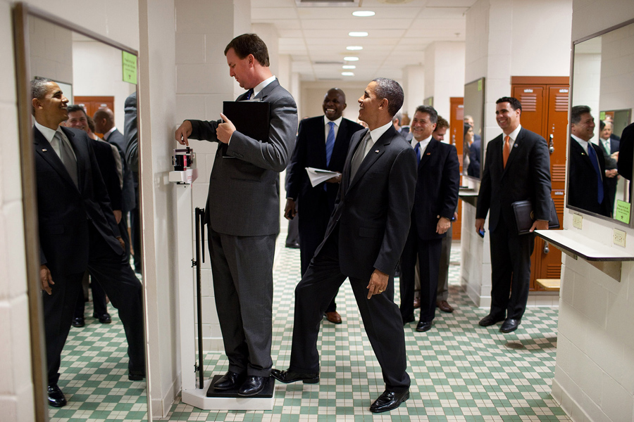
What is Happening in this picture?
Mirrors
Sparse information
3 dimensions
Physics
Mental Models
Mental Models about mental models
Humor
Importance of context, predicting how the scene will evolve

Slide 5
Describe a Giraffe

Slide 6
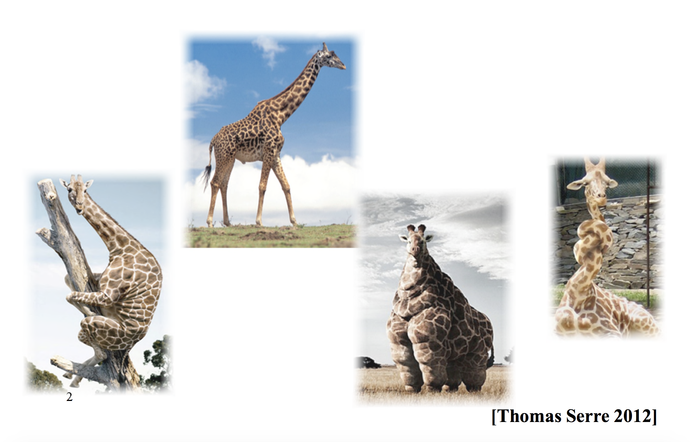

Slide 7
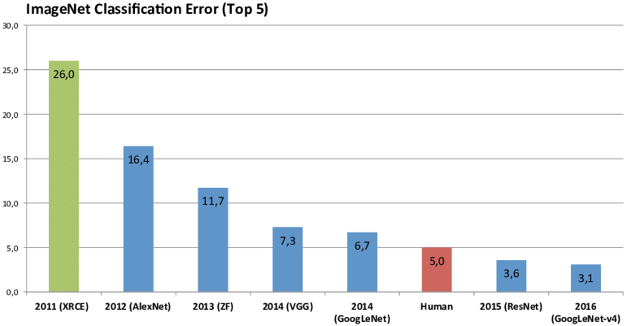
ImageNet Winners since 2011

Slide 8
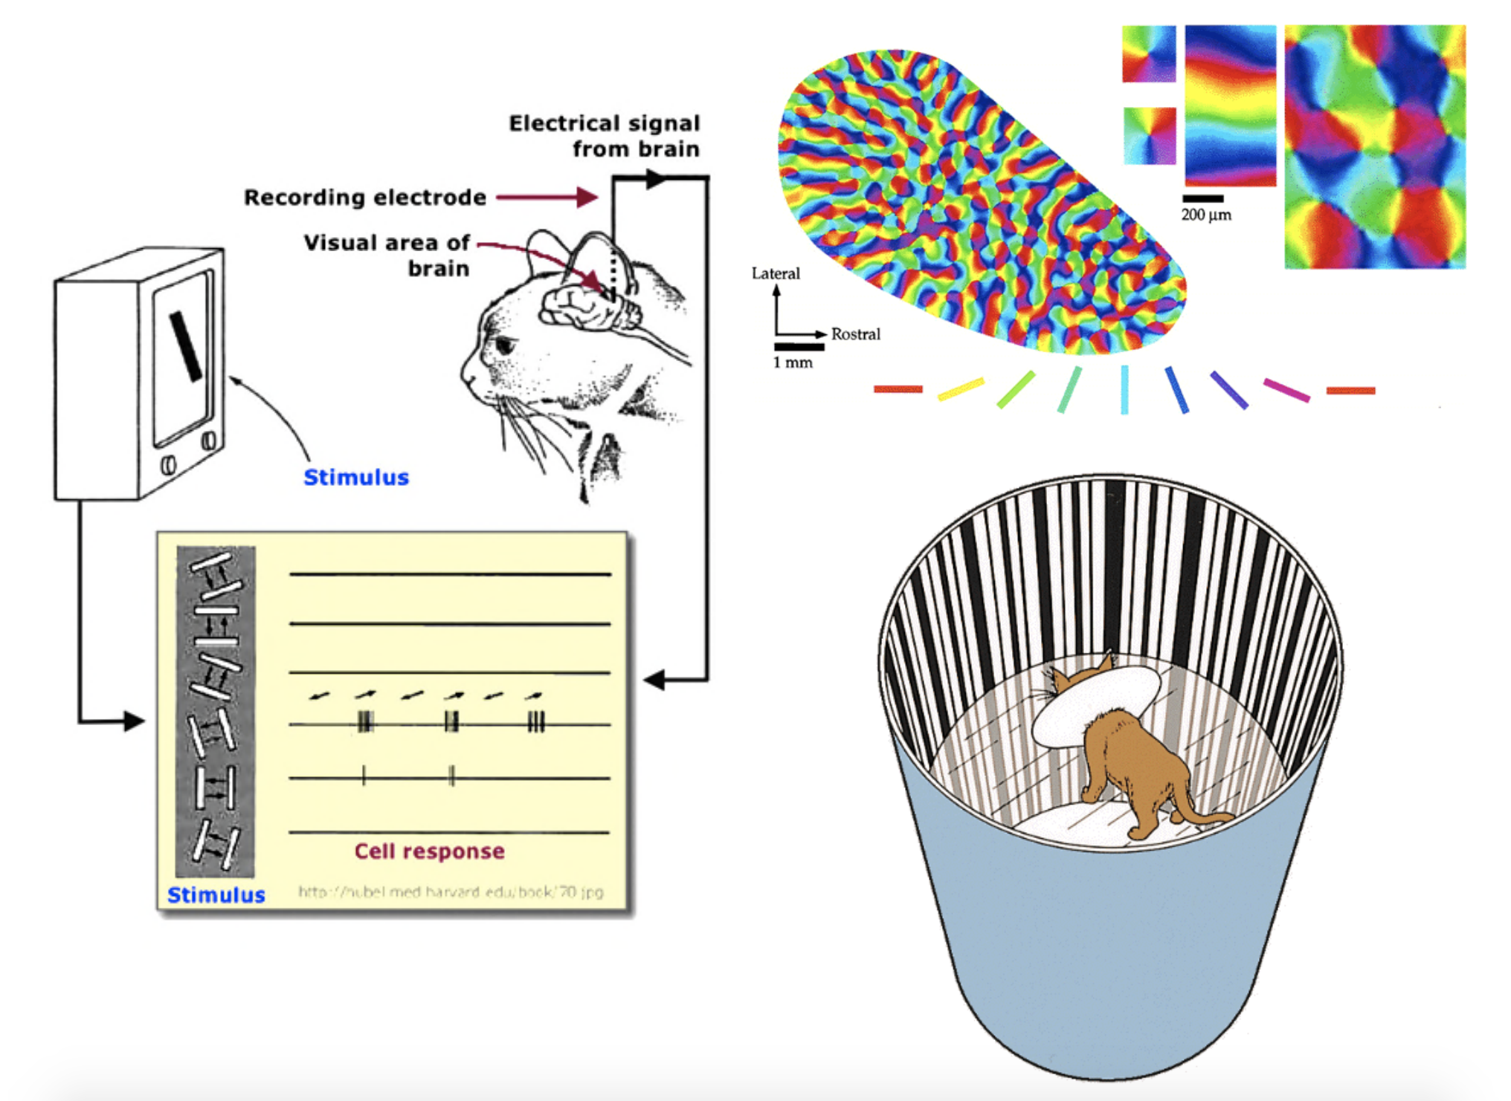
Visual Cortex for Mammals - Hubel and Wiesel

Slide 9
Images in Computers

Slide 10

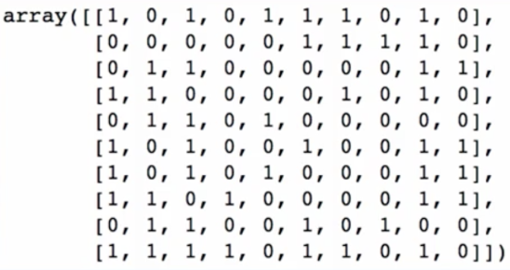
Black and White

Slide 11

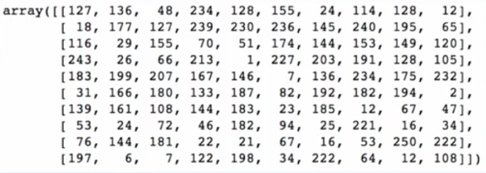
Grayscale

Slide 12

MNIST
5 0 4 1

Slide 13
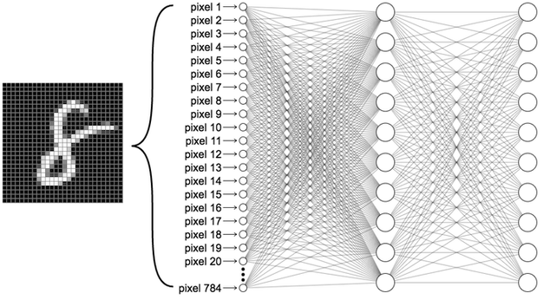
MNIST in Dense Networks

Slide 14
Order | Name | Example | Shape
0 | Scalar | 3 | No Shape
1 | Vector | [4, 6, 0, 5, 7, 1] | (6, )
2 | Matrix | [[0, 1, 2], [6, 7, 8]] | (2, 3)
3 | Tensor | [[[0, 1, 2], [6, 7, 8]], [[0, 1, 2], [6, 7, 8]]] | (2,2,4)
Tensors

Slide 15
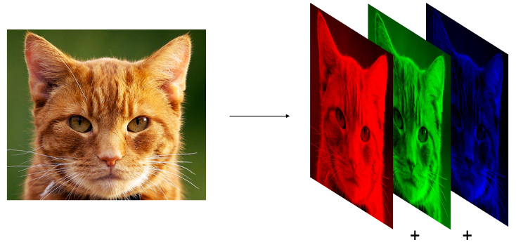
RGB

Slide 16
So what is a Convolution?

Slide 17
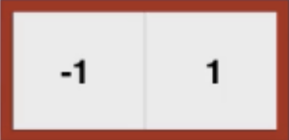

1D Convolution
g
x
x
f
=
g

Slide 18
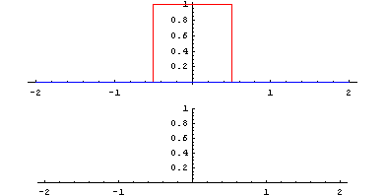
1D Convolution

Slide 19
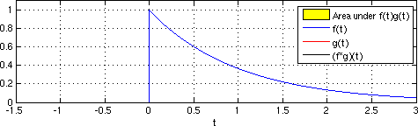
1D Convolution

Slide 20
Code…

Slide 21
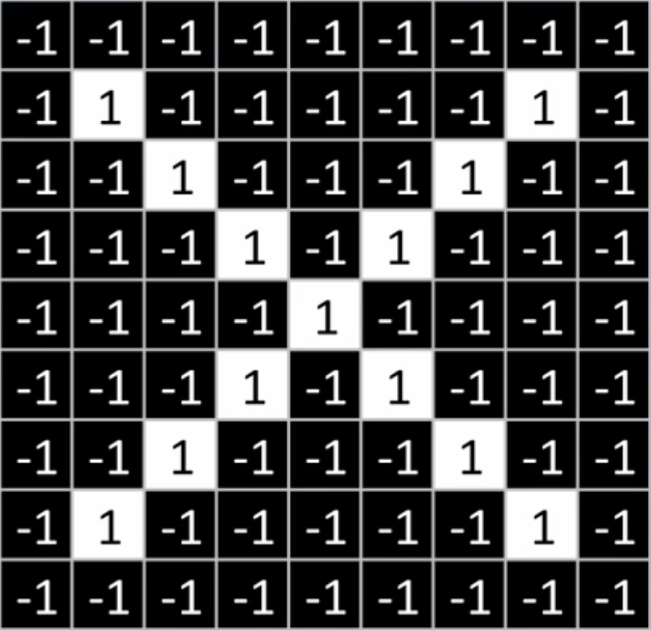
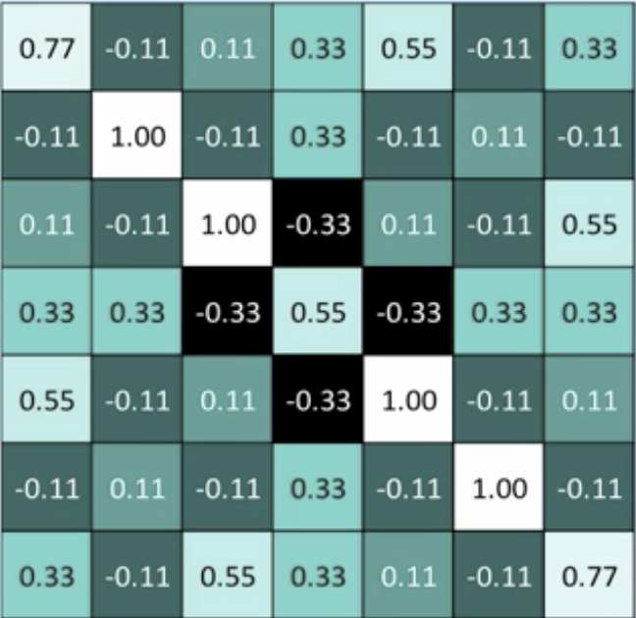
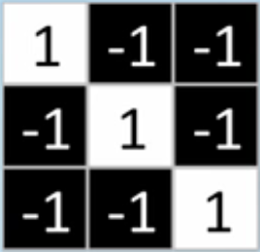
2D Convolution
Reference Image
Result
Kernel or Filter

Slide 22
Code…

Slide 23

Convolutional Layer
The input is an order 4 tensor
(N, H, W, C)
N: Number of Images
H: Height of Images
W: Width of Images
C: Number of color channels
(60000, 28, 28, 1)

Slide 24
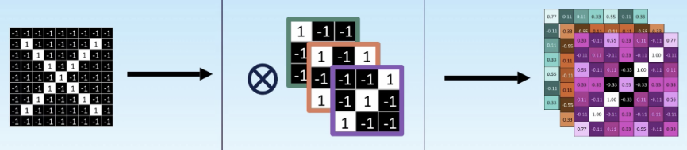
Convolutional Layer
Layer Input
Layer Kernels
Layer Output
(-, 9, 9, 1)
(3, 3, 1, 2)
(-, 7, 7, 2)
Notes:
N, h, w, c
H, w, in channels, # filters
N, h, w, outputs
This creates a big tensor will potentially many output channels if we have many filters

Slide 25
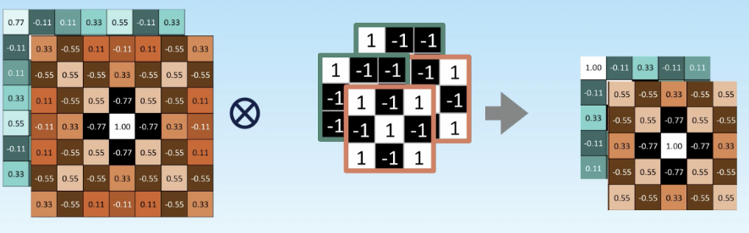
Next Layer
(3, 3, 1, 2)
Notes:
In: (-, 7, 7, 2)
Out: (-, 5, 5, 2)

Slide 26
Code…

Slide 27
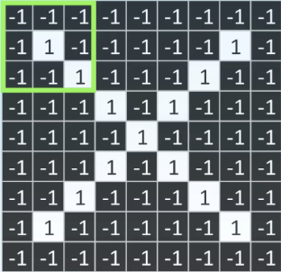
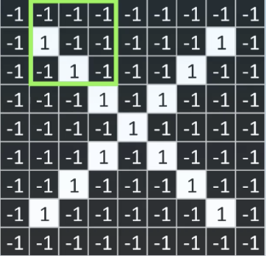
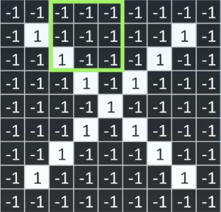
Strides: (1, 1)

Slide 28
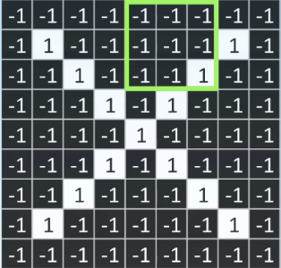
Strides: (2, 2)

Slide 29
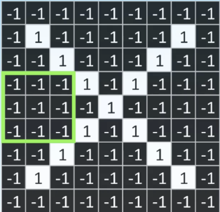
Strides: (3, 1)

Slide 30
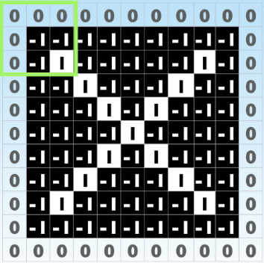
Padding Layer
Valid
Same
Notes:
Valid, just takes the valid inputs, forgets the parts that don’t fit into the kernel, no made up

Slide 31
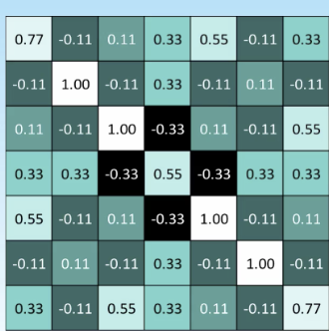
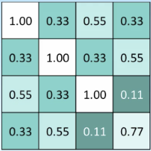
Pooling Layer

Slide 32
Code…

Slide 33

Convolutional Neural Networks… Finally

Slide 34
Comparison: FC vs CNN
Fully Connected
Input data: image 10x10 => 100 numbers
First Layer: 32 nodes => 100 weights
Total => 3200 weights
Convolutional
Input data: image 10x10 => 100 numbers
First Layer: 32 conv, kernels 3x3 => 9 weights each
Total => 32 x 9 = 288 weights

Slide 35
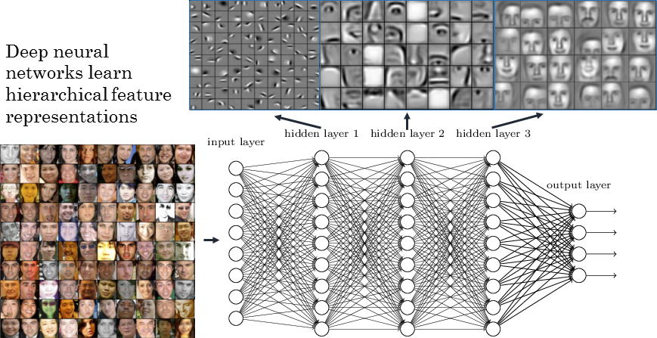
Feature Hierarchy

Slide 36
Code…

Slide 37
Famous Architectures
Names:
LetNet-5
AlexNet
GoogLeNet
VGGNet
ResNet
Xception
SENet

